Slide 1




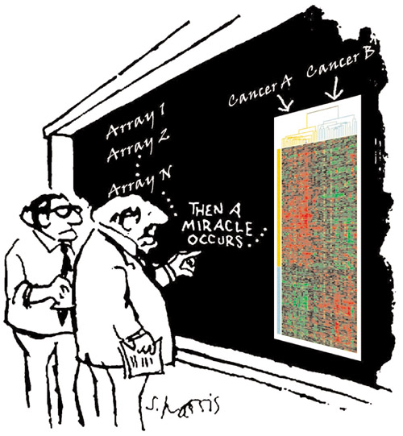
GENE EXPRESSION MICROARRAY PROFILING IN PRACTICE
Ingrid Arijs
Translational Research Center for Gastrointestinal Disorders (TARGID), IBD Leuven, KU Leuven, Leuven, Belgium
ingrid.arijs@med.kuleuven.be
19/11/2013

Slide 2

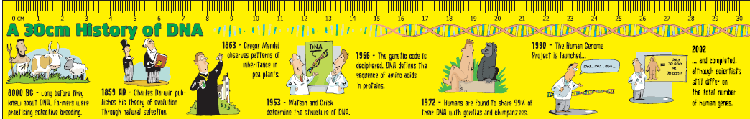
Introduction
Data analysis
Example
Introduction:
Microarray technology is the practical offshoot of the Human Genome Project (HGP) which is completed in 2003
The goals of HGP were to:
  identify all the approximately 20000-25000 genes in human DNA
  determine the sequences of the 3 billion chemical base pairs that
  make up human DNA
  store this information in databases
  improve tools for data analysis
The completion of HGP was not the end, but merely the start of the unraveling of the information hidden in the DNA
Notes:
2

Slide 3
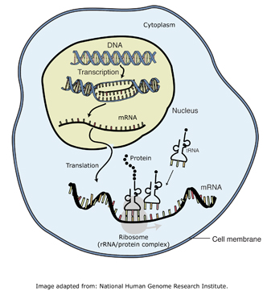
Introduction
Data analysis
Example
Buried within the DNA sequences are the genes
(i.e. DNA sequences that code for proteins).
Genes (mRNA) within the genome only come into play
in a cell when they are "expressed."
The differences in gene expression among
cells is what makes them unique
(i.e. what distinguishes a neuron from a kidney cell).
To study which are active and which are inactive in different cell types helps scientist to understand both how these cells function normally and how they are affected when various genes do not perform properly.
Already since the mid-1970s, we were capable of measuring gene expression, with techniques called Southern blotting and later with Northern blotting.
Notes:
3
3

Slide 4
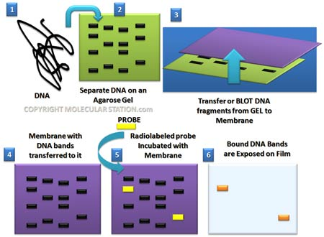
Introduction
Data analysis
Example
Southern blotting is used to recognize a DNA sequence and uses a piece of DNA as probe of DNA,
whereas Northern blotting uses a piece of
mRNA as probe and is applied to recognize
RNA sequences.
For both methods the probe is
radioactively labeled and hybridized to
a complementary fragment of DNA or RNA
that has been previously seperated according
to molecular weight (size) by gel
electroforesis. In Northern blot analysis, the amount of radioactivity is a function of the amount of probe hybridized, which reflect the amount of mRNA in the sample.
But these techniques could only focus one gene at a time.
With the development of gene expression microarray technology, we can now examine how active thousands of genes are at any time.
Notes:
4
4

Slide 5

Introduction
Data analysis
Example
A microarray can be understood as performing thousands of Southern or Northern blottings in parallel. Instead of distributing one probe over a gel with RNA or DNA, thousands of probes are attached to a solid surface, which will become the microarray, and the RNA sample is spread over these probes.
The use of microarrays for gene expression profiling was first published in 1995 by Schena et al.
Notes:
5
5

Slide 6

Introduction
Data analysis
Example
Gene expression microarrays:
  Powerful tool for measuring simultaneously expression of thousands of genes in one single experiment
  Comprehensive picture of gene expression at tissue/cellular level
  Comparing gene expression profiles between clinical conditions
    To identify diagnostic and prognostic biomarkers
Notes:
6
6

Slide 7
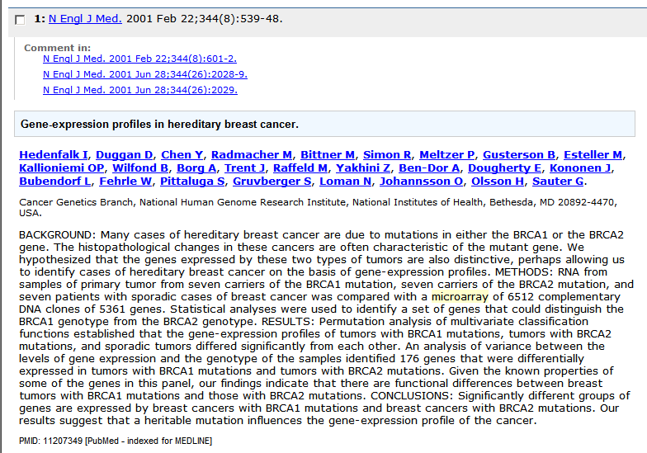
Introduction
Data analysis
Example
Gene expression microarrays:
  Powerful tool for measuring simultaneously expression of thousands of genes in one single experiment
  Comprehensive picture of gene expression at tissue/cellular level
  Comparing gene expression profiles between clinical conditions
    To classify diseases (e.g. different types of breast cancer)
Notes:
7
7

Slide 8
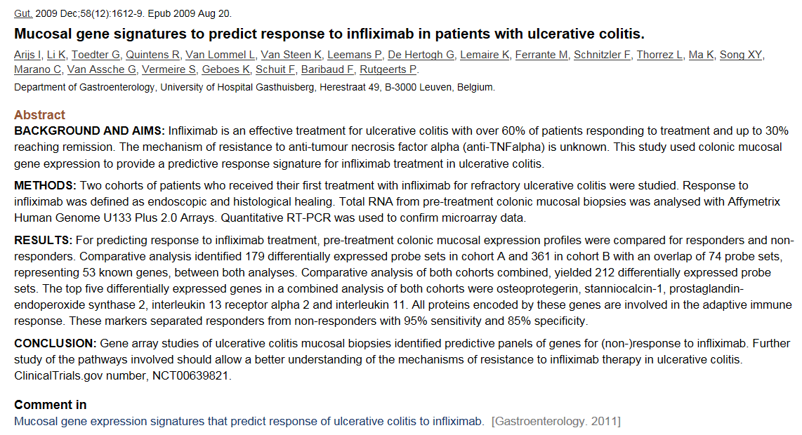
Introduction
Data analysis
Example
Gene expression microarrays:
  Powerful tool for measuring simultaneously expression of thousands of genes in one single experiment
  Comprehensive picture of gene expression at tissue/cellular level
  Comparing gene expression profiles between clinical conditions
    To monitor response to therapy
Notes:
8
8

Slide 9
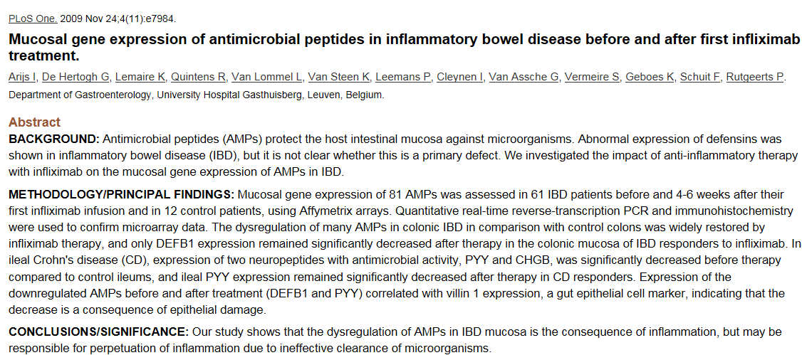
Introduction
Data analysis
Example
Gene expression microarrays:
  Powerful tool for measuring simultaneously expression of thousands of genes in one single experiment
  Comprehensive picture of gene expression at tissue/cellular level
  Comparing gene expression profiles between clinical conditions
    To understand mechanisms in the pathogenesis of diseases
Notes:
9
9

Slide 10
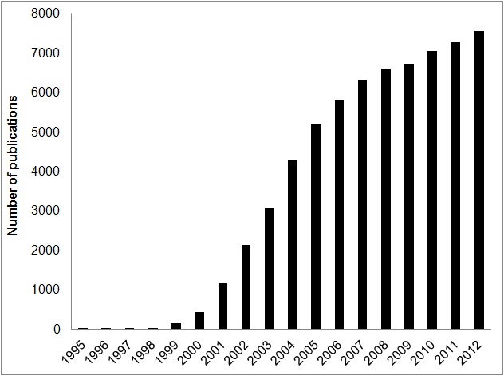
Introduction
Data analysis
Example
Microarrays have become an important research tool for functional genomics (= deconstruction of the genome to determine the biological function of genes and gene interactions) and will lead to new discoveries in clinical medicine. The use of microarrays grows exponentially.
Figure: Number of publications on microarray related research. The histogram shows a rapid increase in number of publications involving microarrays in the last 18 years. The numbers correspond to the number of publications containing ‘microarray’, ‘microarrays’, ‘micro-array’, ‘micro-arrays’ in the titles or abstracts as stored in the pubmed database (www.pubmed.gov)
Notes:
10
10

Slide 11
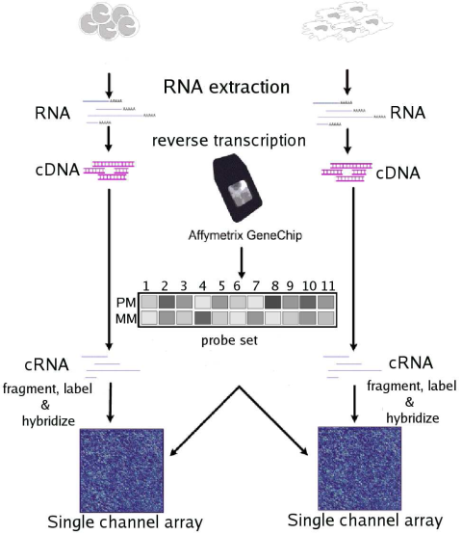
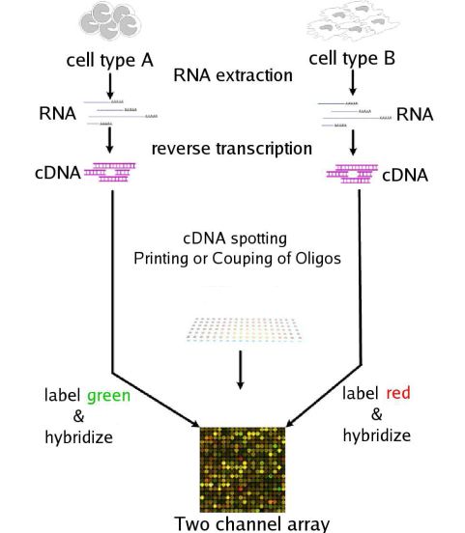
Introduction
Data analysis
Example
Types of microarrays: gene expression microarrays can be broadly classified according to at least three criteria
  Length of the probes
    cDNA probe (PCR products)
    Oligos (oligonucleotides)
  Manufacturing method
    spotting on a glass slide
    in-situ synthesis on a glass slide
  Number of samples that can be simultaneously profiled on one array
    single channel arrays: only one sample is hybridized to the arrays labelled with one dye
    dual channel arrays: two samples are hybridized to the arrays, each labelled with a different dye, this allows the simultaneous measurement of two samples
Notes:
11
11

Slide 12
Introduction
Data analysis
Example
Types of microarrays: Microarrays can be broadly classified according to at least three criteria
  Length of the probes
    cDNA probe (PCR products) (cDNA arrays)
    Oligos (oligonucleotides) (oligonucleotide arrays)
  Manufacturing method
    spotting on a glass slide (cDNA arrays)
    in-situ synthesis on a glass slide (oligonucleotide arrays)
  Number of samples that can be simultaneously profiled on one array
    single channel arrays: only one sample is hybridized to the arrays labelled with one dye (oligonucletide arrays)
    dual channel arrays: two samples are hybridized to the arrays, each labelled with a different dye, this allows the simultaneous measurement of two samples (cDNA arrays)
Two basic variations of high-density DNA arrays:
  cDNA microarrays: robotic spotting and immobilization of purified cDNA inserts to glass slides
  oligonucleotide arrays (Affymetrix GeneChip array): in-situ synthesis of oligonucleotides on silica wafers or “chips”
Notes:
12
12

Slide 13
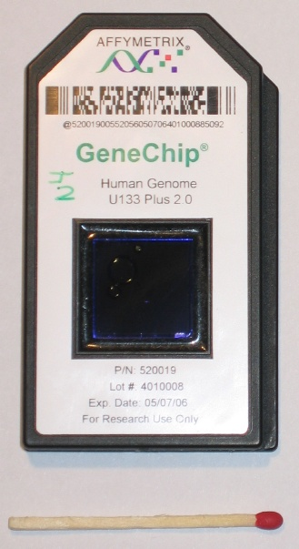
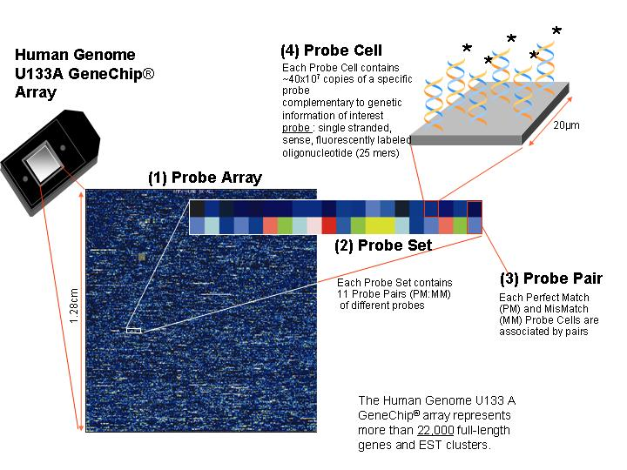
Introduction
Data analysis
Example
Focus today on Affymetrix gene expression arrays:
  These arrays are based on the use of a single colour label. The chips use oligonucleotides (which are short fragments of a single-stranded DNA) as probes to achieve higher packing density and less manufacturing errors. One feature or probe cell is composed of a large number of identical oligonucleotides of 25 bases that are synthesized onto the chip.
Notes:
13
13

Slide 14
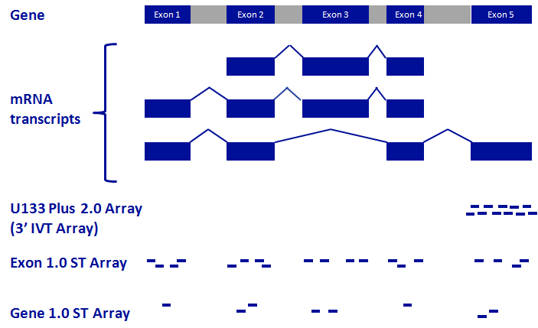
Introduction
Data analysis
Example
Different types of Affymetrix gene expression microarrays:
“Gene-level”
1 signal for entire gene
Notes:
14
14

Slide 15
Introduction
Data analysis
Example
Different types of Affymetrix gene expression microarrays offering whole-genome wide gene expression analysis:
“Exon-level”
1 signal for every exon
Notes:
15
15
Affymetrix has 3 types of arrays offering whole-genome wide gene expression analysis. In my previous studies, we used the U133 plus 2.0 arrays which have mainly probes targeting the sequences at the 3’ end of the gene. In contrast, the other 2 types of arrays have probes targeting each exon of the gene. All the 3 arrays can be used to measure the expression at gene level, while the last two types of arrays can also be used to measure the expression at exon level giving the ability to look at the alternative splicing variants.

Slide 16
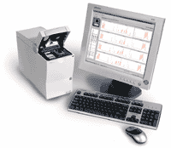
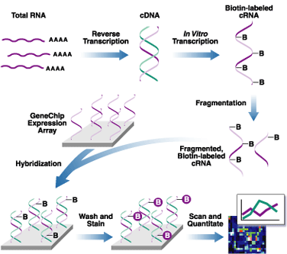
Introduction
Data analysis
Example
Schematic overview on the different steps while performing an Affymetrix GeneChip experiment
Notes:
16
16
The total RNA is isolated from the tissue/cell being studied.
The RNA is turned into a double stranded cDNA. This is done through reverse transcription. This is done because RNA itself is not a very stable molecule and the cDNA is a way to store the RNA for a much longer period of time
When it comes time to run the array, the cDNA is allowed to go through in vitro transcription back to RNA (now known as cRNA), but this RNA is labeled with Biotin. This is done by having all the uracil bases tagged with the Biotin.
This labeled cRNA is then randomly fragmented in to pieces anywhere from 30 to 400 base pairs in length
The fragmented, Biotin-labeled cRNA is then added to the array
Anywhere on the array where a RNA fragment and a probe are complimentary, the RNA hybridizes to the probes in the feature.
The array is then washed to remove any RNA that is not stuck to an array (i.e., no match was made) and then stained with the fluorescent molecule that sticks to Biotin (Cy5 conjugated to streptavidin)
Lastly, the entire array is scanned with a laser. The resulting image files (.dat files) were analyzed using Affymetrix GCOS software, and intensity values for each probe cell (.cel file) were calculated. Quality evaluation of the microarrays included Spike-In controls (BioB, BioC, BioD, and cre), a 3’-5’ ratio of GAPDH < 3.0, and average background signal < 100.

Slide 17
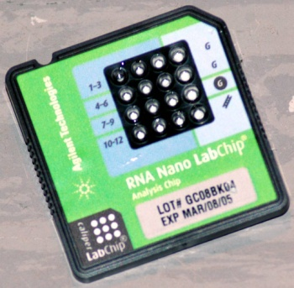
Introduction
Data analysis
Example
RNA quality control: Agilent bioanalyzer 2100
Good RNA sample quality measured with the bioanalyzer
Degraded RNA sample quality measured with the bioanalyzer
Notes:
17
17

Slide 18
Introduction
Data analysis
Example
Schematic overview on the different steps while performing an Affymetrix GeneChip experiment
Notes:
18
18
The total RNA is isolated from the tissue/cell being studied.
The RNA is turned into a double stranded cDNA. This is done through reverse transcription. This is done because RNA itself is not a very stable molecule and the cDNA is a way to store the RNA for a much longer period of time
When it comes time to run the array, the cDNA is allowed to go through in vitro transcription back to RNA (now known as cRNA), but this RNA is labeled with Biotin. This is done by having all the uracil bases tagged with the Biotin.
This labeled cRNA is then randomly fragmented in to pieces anywhere from 30 to 400 base pairs in length
The fragmented, Biotin-labeled cRNA is then added to the array
Anywhere on the array where a RNA fragment and a probe are complimentary, the RNA hybridizes to the probes in the feature.
The array is then washed to remove any RNA that is not stuck to an array (i.e., no match was made) and then stained with the fluorescent molecule that sticks to Biotin (Cy5 conjugated to streptavidin)
Lastly, the entire array is scanned with a laser. The resulting image files (.dat files) were analyzed using Affymetrix GCOS software, and intensity values for each probe cell (.cel file) were calculated. Quality evaluation of the microarrays included Spike-In controls (BioB, BioC, BioD, and cre), a 3’-5’ ratio of GAPDH < 3.0, and average background signal < 100.

Slide 19
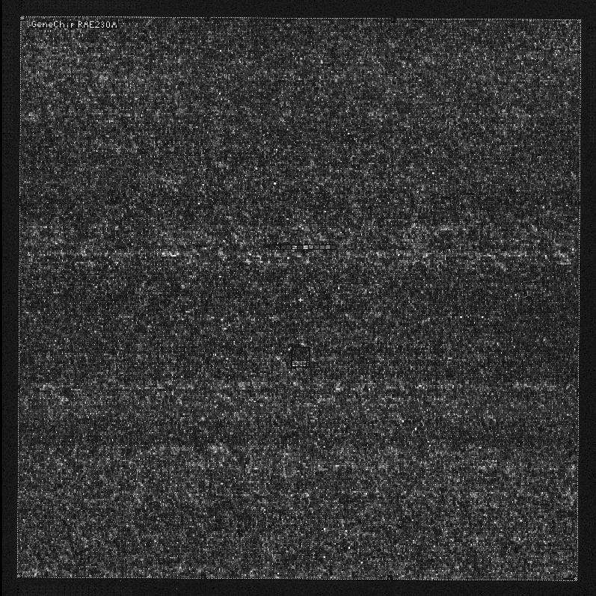
Introduction
Data analysis
Example
The result is a DAT file: the image of a scanned probe array, analysed with Affymetrix GeneChip® Operating (GCOS) Software
Notes:
19
19

Slide 20
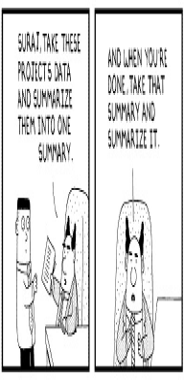
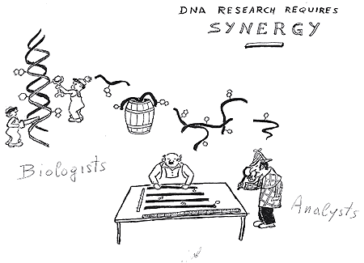
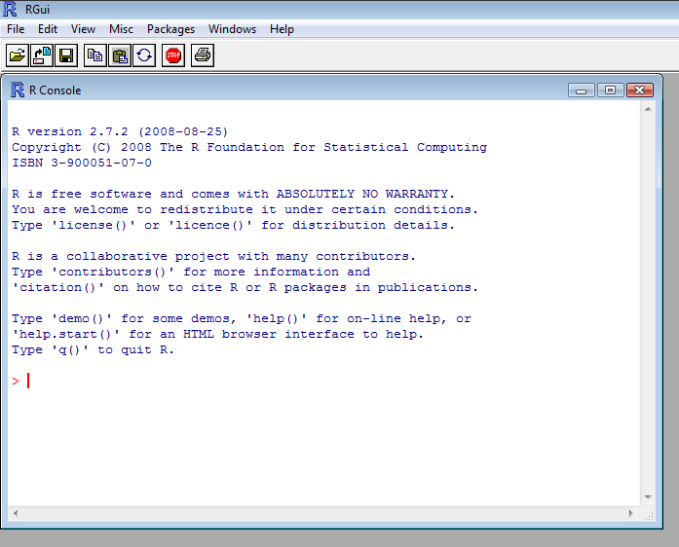
Introduction
Data analysis
Example
Microarray data analysis process
from raw data to biological significance
Microarray experiments generate enormous
amount of data. This is a
biologist’s nightmare,
however it is a bioinformatician’s
dream.
Focus today on the data analysis of Affymetrix Human Genome U133 Plus 2.0 arrays with Bioconductor software
  A free, open source and open development software project for the analysis and comprehension of genomic data. It is based on the statistical R programming language.
  http://www.bioconductor.org/
Notes:
20
20

Slide 21
Introduction
Data analysis
Example
Biological question
Experimental design
Microarray experiment
Image analysis
Normalization
Data analysis
Biological verification
and interpretation
Making data public
Notes:
21
21

Slide 22
Introduction
Data analysis
Example
3 major types of applications of microarrays in medicine:
  Class comparison (differential expression) study:
    It involves the comparison of gene expression profiles of samples from distinct, predifend groups to identify the genes that are differentially expressed (DE) among the groups.
      e.g. finding DE genes in the colon from normal patients and patients with ulcerative colitis.
  Class prediction (classification) study:
    It develops a classifier that uses the gene expression level of multiple genes that can be applied to the expression profile of a newly sample to predict its (unknown) class).
      e.g. a classifier that distinguishes between 2 different disease states
  Class discovery (clustering, unsupervised learning) study:
    It involves analyzing a given set of gene expression profiles with the goal of discovering subgroups that share common features.
    It differs from the other studies because the classes are not predefined
Biological question
Experimental design
Microarray experiment
Image analysis
Normalization
Data analysis
Biological verification
and interpretation
Making data public
Notes:
22
22

Slide 23
Introduction
Data analysis
Example
Type of experiment:
  Two groups
    Control vs treated
  Three or more groups, single factor
    Time series
  Four or more groups, multiple factors
    Time series with control and treated cells
Replicates
  The more the better, but at least 3
  Biological better than technical
  Technical replication is in which the same biological sample is assayed several times
  Biological replication refers to measuring multiple independent biological samples for each category of interest.
Biological question
Experimental design
Microarray experiment
Image analysis
The type of experiment and number of groups and factors will determine the statistical methods needed to detect differential expression
Normalization
Data analysis
Biological verification
and interpretation
Making data public
Notes:
23
23

Slide 24


Introduction
Data analysis
Example
Affymetrix gene expression array experiments:
Biological question
Experimental design
Microarray experiment
Image analysis
DAT files
Normalization
The image of a scanned probe array
Data analysis
CEL files = processed .DAT file
It contains a single intensity value for each probe cell delineated by the grid
Biological verification
and interpretation
For normalization and data analysis, the CEL files are loaded in Bioconductor
Making data public
Notes:
24
24

Slide 25
Introduction
Data analysis
Example
Normalisation:
  Goals:
    to compensate for technical differences between chips, to see more clearly the biological differences between samples
  Sources of technical variations:
    Differences in the labelling
    Differences in the sample preparation
    Differences in the hybridization
    Differences in the photo-detection
    ….
  Allows comparisons across arrays
  Transform intensity values to expression values:
    Algorithms:
      MAS5
      RMA (robust multichip average)
      GCRMA
      ….
    I will discuss in more detail the steps in the RMA algorithm
Biological question
Experimental design
Microarray experiment
Image analysis
Normalization
Data analysis
Biological verification
and interpretation
Making data public
Notes:
25
25

Slide 26
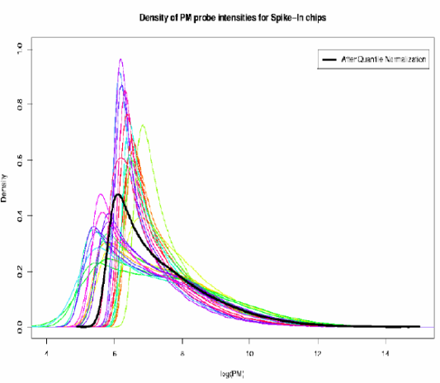
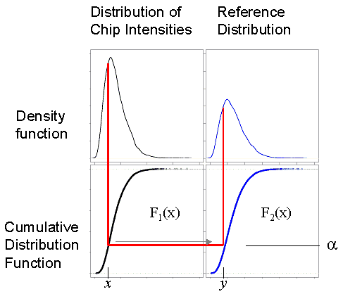
Introduction
Data analysis
Example
RMA method:
  Robust Multichip Average method* = a data pre-processing method to compute expression summary values for each probe set
  Implemented in the package Affy in the Bioconductor software
  Consist of 3 steps:
    Probe-specific background correction to compensate for non-specific binding using PM distribution rather than PM-MM values
    Probe-level multichip quantile normalization to unify PM distributions across all chips
      Fit all the chips to the same distribution
    Robust probe-set summary of the log-normalized probe-level data by median polishing
Biological question
Experimental design
Microarray experiment
Image analysis
Normalization
Data analysis
Biological verification
and interpretation
Making data public
* Irizarry RA, Biostatistics 2003
Notes:
26
26

Slide 27
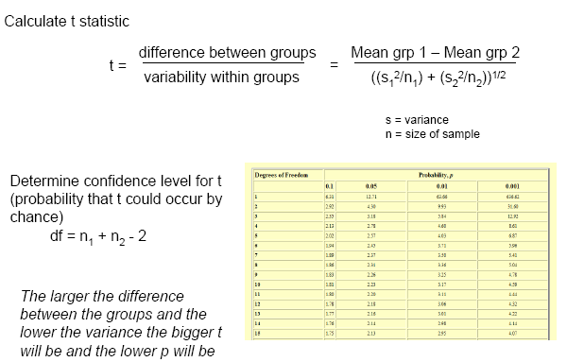
Introduction
Data analysis
Example
Class comparison experiment:
  e.g. to identify the genes that are DE between two groups
    The “null hypothesis” is that a given gene on the array is not DE between the two conditions under study
    The “alternative hypothesis” is that the expression level of that gene is different between the two conditions
    The hypothesis testing is performed by calculating e.g. t-test on the expression values of the gene measured in the two groups:
Biological question
Experimental design
Microarray experiment
Image analysis
Normalization
Data analysis
Biological verification
and interpretation
Making data public
Notes:
27
27

Slide 28
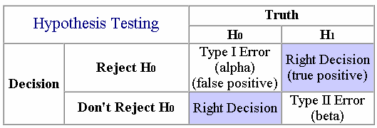
Introduction
Data analysis
Example
Class comparison experiment:
  Two types of errors in hypothesis testing:
  Multiple testing correction:
    Microarray studies typically involve the simultaneous testing of hundreds or thousands of genes for differential expression. This results in a large number of falsely significant results. Therefore we must correct for multiple testing.
    Multiple testing correction is a method for adjusting the p-value from a comparison test based on the number of test performed. These adjusments help to reduce the number of false positives in an experiment
Biological question
Experimental design
Microarray experiment
Image analysis
Normalization
Data analysis
Biological verification
and interpretation
Making data public
Notes:
28
28

Slide 29
Introduction
Data analysis
Example
Class comparison experiment:
  Multiple testing corrections:
    Family Wise Error Rate (FWER) : the probability of at least one false positive for all comparisons
      Bonferonni correction (α/number comparisons), Holm’s test
    False Discovery Rate (FDR) : the expected proportion of false positives among the results
      Benjamini and Hochberg (BH), Significance Analysis of Microarrays (SAM)
    Example: 1000 genes and 50 DE using cutoff of 5%
      FWER: using 5% FWER means there is a 5% chance that you have at least 1 false positive . For Bonferonni correction the p-value of DE genes is < 0.00005 (0.05/1000). This is very good and would be a very conservative requirement, you are conficent that all of your results are real.
      FDR: using 5% FDR you would expect 2.5 false positives (5% of 50). This is probably acceptable, you are confident that most of your results are real.
  In Bioconductor software: package LIMMA¹ for moderated t-statistics with multiple testing correction and package SIGGENES for SAM²
Biological question
Experimental design
Microarray experiment
Image analysis
Normalization
Data analysis
Biological verification
and interpretation
Making data public
¹ Smyth GK Stat Appl Genet Mol Biol 2004 ²Tusher VG Proc Natl Acad Sci USA 2001
Notes:
29
29

Slide 30
Introduction
Data analysis
Example
Class prediction experiment:
  Numerous methods:
    logistic regression
    linear and quadratic discriminant analysis,
    nearest neighbor classifiers
    decision trees
    shrunken centroids
    neural networks
    random forests
    support vector machines
    ……
  I used the PAM method in my research
    Predictive Analysis of Microarrays (PAM)¹
      Bioconductor software: package PAMR
    A statistical technique for class prediction from gene microarray data using nearest shrunken centroids.
      It identifies a subset of genes that best characterizes the class identity and this subset can be used to predict the class of new samples.
Biological question
Experimental design
Microarray experiment
Image analysis
Normalization
Data analysis
Biological verification
and interpretation
Making data public
¹ Tibshirani R Proc Natl Acad Sci USA 2002
Notes:
30
30

Slide 31
Introduction
Data analysis
Example
Class prediction experiment:
  PAM method
    Nearest shrunken centroid method:
      Modification of nearest centroid method, which computes a standardized centroid for each class in the training set. This is the average gene expression for each gene in each class divided by the within-class standard deviation for that gene.
        Nearest centroid classification takes the gene expression profile of a new sample, and compares it to each of these class centroids. The class, whose centroid it is closest to, in squared distance, is the predicted class for that new sample.
Biological question
Experimental design
Microarray experiment
Image analysis
Normalization
Data analysis
Biological verification
and interpretation
Making data public
Notes:
31
31

Slide 32
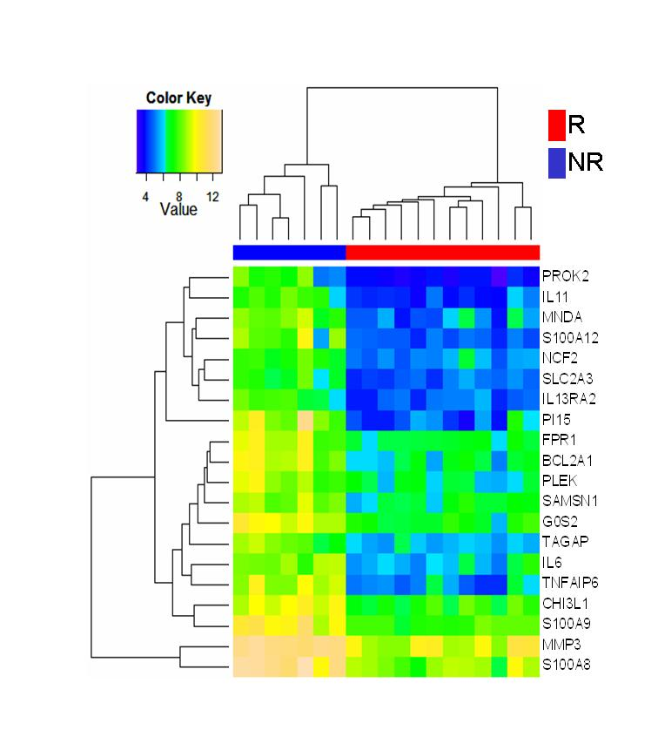
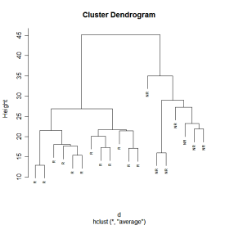
Introduction
Data analysis
Example
Class discovery experiment:
  It involves analyzing a given set of gene expression profiles with the goal of discovering subgroups that share common features
  The analyses for class discovery are unsupervised
    Analysis without prior knowledge of sample identity
    Clustering analysis
      It divides data points (genes or samples) into groups (clusters) using measures of similarity, such as correlation or Euclidian distance .
      Complete, average or single linkage clustering.
      e.g. Hierarchical clustering analysis
        The end result is a cluster tree or dendogram
        The result can also be displayed as
        a 2-dimensional heatmap
        with 2 dendograms,
        one indicating the
        similarity between
        patients and the other
        indicating the similarity
        between genes.
Biological question
Experimental design
Microarray experiment
Image analysis
Normalization
Data analysis
Biological verification
and interpretation
Making data public
Notes:
32
32

Slide 33
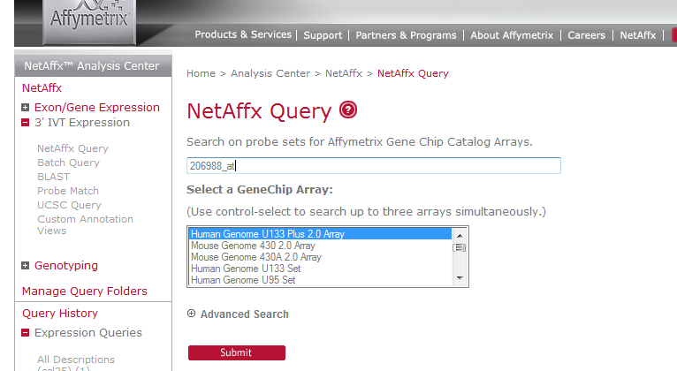
Introduction
Data analysis
Example
Probe set annotations:
  Affymetrix NetAffx website (http://www.affymetrix.com/analysis/index.affx)
    Example: 206988_at from Affymetrix Human Genome 133 plus 2.0 array
Biological question
Experimental design
Microarray experiment
Image analysis
Normalization
Data analysis
Biological verification
and interpretation
Making data public
Notes:
33
33

Slide 34
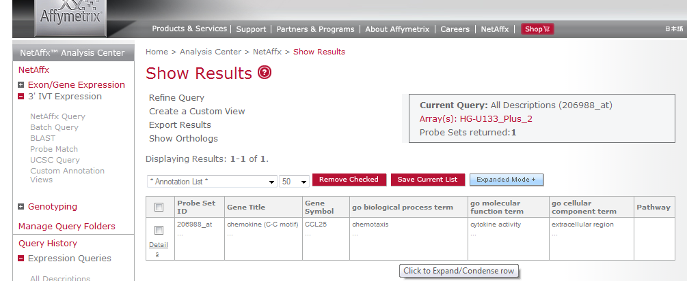
Introduction
Data analysis
Example
Probe set annotations:
  Affymetrix NetAffx website (http://www.affymetrix.com/analysis/index.affx)
    Example: 206988_at from Affymetrix Human Genome 133 plus 2.0 array
Biological question
Experimental design
Microarray experiment
Image analysis
Normalization
Data analysis
Biological verification
and interpretation
Making data public
Notes:
34
34

Slide 35
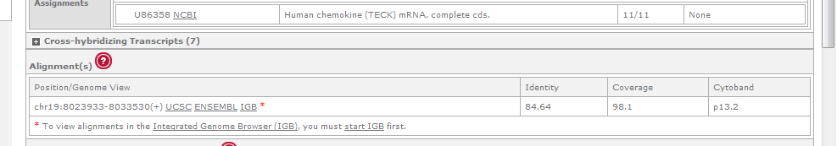
Introduction
Data analysis
Example
Probe set annotations:
  Affymetrix NetAffx website (http://www.affymetrix.com/analysis/index.affx)
    Example: 206988_at from Affymetrix Human Genome 133 plus 2.0 array
Biological question
Experimental design
Microarray experiment
Image analysis
Normalization
Data analysis
Biological verification
and interpretation
Making data public
Notes:
35
35

Slide 36
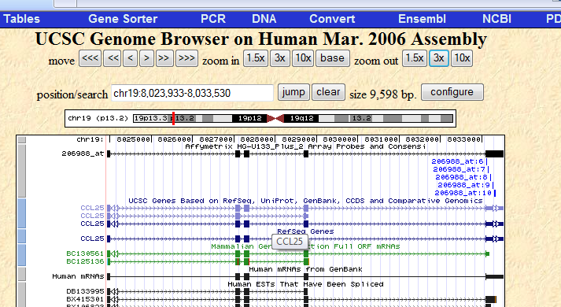
Introduction
Data analysis
Example
Probe set annotations:
  Affymetrix NetAffx website (http://www.affymetrix.com/analysis/index.affx)
    Example: 206988_at from Affymetrix Human Genome 133 plus 2.0 array
Biological question
Experimental design
Microarray experiment
Image analysis
Normalization
Data analysis
Biological verification
and interpretation
Making data public
Notes:
36
36

Slide 37
Introduction
Data analysis
Example
Functional analysis:
  to identify which biological processes and/or diseases are overrepresented among sets of significant probe sets
  Programs:
    Ingenuity Pathway Analysis (Ingenuity Systems®, www.ingenuity.com)
    GenMapp (http://www.genmapp.org/)
    DAVID homepage (http://david.abcc.ncifcrf.gov/home.jsp)
    Bioconductor software: package topGO
    Gene Ontology Enrichtment Analysis Software Toolkit (GOEAST)
Biological question
Experimental design
Microarray experiment
Image analysis
Normalization
Data analysis
Biological verification
and interpretation
Making data public
Notes:
37
37

Slide 38
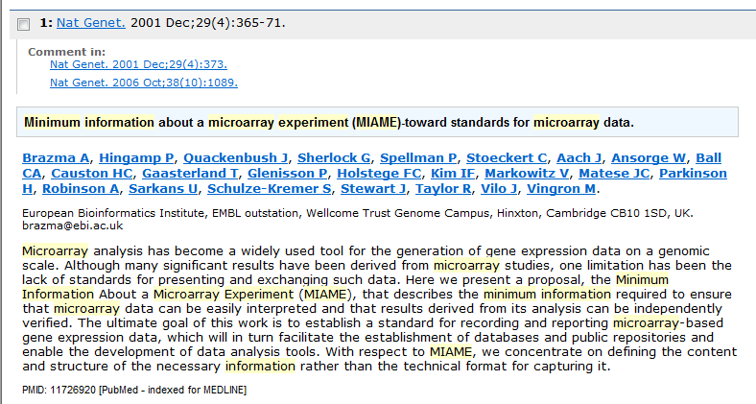
Introduction
Data analysis
Example
MIAME:
  For publishing microarray based papers, most of the journals require MIAME compliant data.
  It describes the Minimum Information About a Microarray Experiment that is needed to enable the interpretation of the results of the experiment unambiguously and potentially to reproduce the experiment.
Biological question
Experimental design
Microarray experiment
Image analysis
Normalization
Data analysis
Biological verification
and interpretation
Making data public
Notes:
38
38

Slide 39
Introduction
Data analysis
Example
MIAME:
  MIAME requirements:
    The raw data for each hybridisation (e.g., CEL or GPR files)
    The final processed (normalised) data for the set of hybridisations in the experiment (study) (e.g., the gene expression data matrix used to draw the conclusions from the study)
    The essential sample annotation including experimental factors and their values (e.g., compound and dose in a dose response experiment)
    The experimental design including sample data relationships (e.g., which raw data file relates to which sample, which hybridisations are technical, which are biological replicates)
    Sufficient annotation of the array (e.g., gene identifiers, genomic coordinates, probe oligonucleotide sequences or reference commercial array catalog number)
    The essential laboratory and data processing protocols (e.g., what normalisation method has been used to obtain the final processed data)
  The public repositories ArrayExpress at the EBI (UK), Gene Expression Omnibus (GEO) at NCBI (US) and CIBEX at DDBJ (Japan) are designed to accept, hold and distribute MIAME compliant microarray data.
Biological question
Experimental design
Microarray experiment
Image analysis
Normalization
Data analysis
Biological verification
and interpretation
Making data public
Notes:
39
39

Slide 40

Introduction
Data analysis
Example
Example:
Notes:
40

Slide 41


Introduction
Data analysis
Example
Introduction
Ulcerative colitis
  = a chronic inflammatory bowel disease (IBD) involving the colonic mucosa
  Symptoms: abdominal pain, bloody diarrhoea, fatigue, fever and weight loss
  The pathogenesis of UC remains unknown but chronic inflammation probably results from an interaction of genetic factors, the immune response to microbial dysbiosis and environmental factors.
In the last decades, great progress has been made in the treatment of IBD, especially regarding biological therapeutics
Infliximab (Remicade®):
  the first clinically available biological treatment for IBD
  a chimeric monoclonal IgG1 antibody against TNF-α
  Up to 30% of the patients do not respond to the treatment
It’s important to identify markers for response to infliximab (IFX) in order to optimize the use of this costly drug
Notes:
41

Slide 42
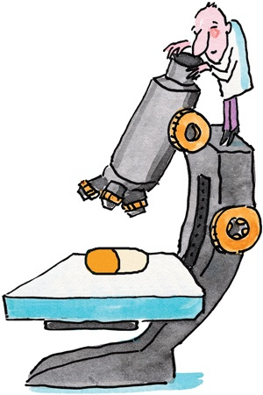
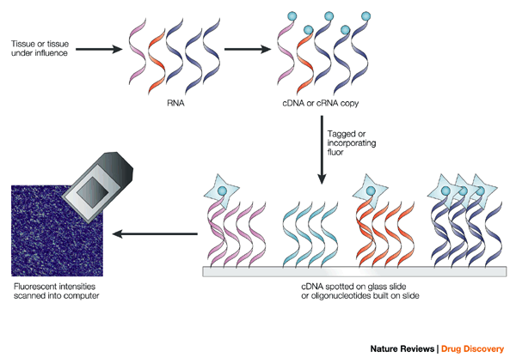
Introduction
Data analysis
Example
Aim of the study
To identify mucosal gene signatures predictive of response to infliximab in UC
using gene expression microarray technology
A tool that allows a simultaneous wide survey of gene expression
Notes:
42

Slide 43
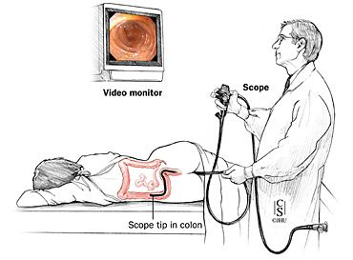
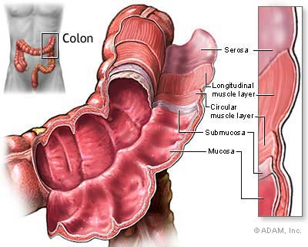

Introduction
Data analysis
Example
Methods and results:
Patients and tissue specimens:
Two independent cohorts of UC patients who received a first treatment with IFX were studied:
  Cohort A: 24 UC patients
  Cohort B: 23 UC patients
Mucosal biopsies were obtained at routine
colonoscopy:
  from diseased colon before and 4-8 weeks after
  first IFX (5 or 10 mg per kg body weight) infusion
All biopsies were blindly scored for inflammation using the histological scoring system from Geboes et al., Gut 2000
Notes:
43

Slide 44
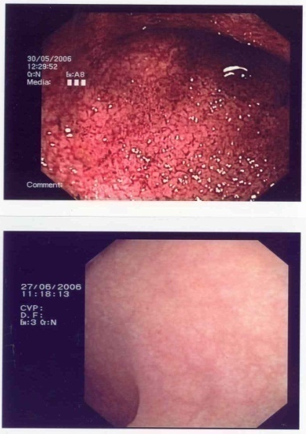
Introduction
Data analysis
Example
Patients and tissue specimens:
Response to IFX was assessed at 4-6 weeks after first IFX infusion and defined as complete endoscopic and histologic healing of the lesions:
UC
46 patients
UC cohort A
24 patients
Responders
8 patients
Non-responders
16 patients
UC cohort B
22 patients
Responders
12 patients
Non-responders
10 patients
Notes:
44

Slide 45
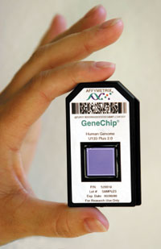
Introduction
Data analysis
Example
Microarray analysis:
Total RNA was isolated, labelled and hybridized to Affymetrix HGU133 Plus 2.0 array:
  comprised of 54675 probesets
  “whole genome” coverage
Microarray data analyses with the CEL files
It contains a single intensity value for each probe cell delineated by the grid
Notes:
45

Slide 46

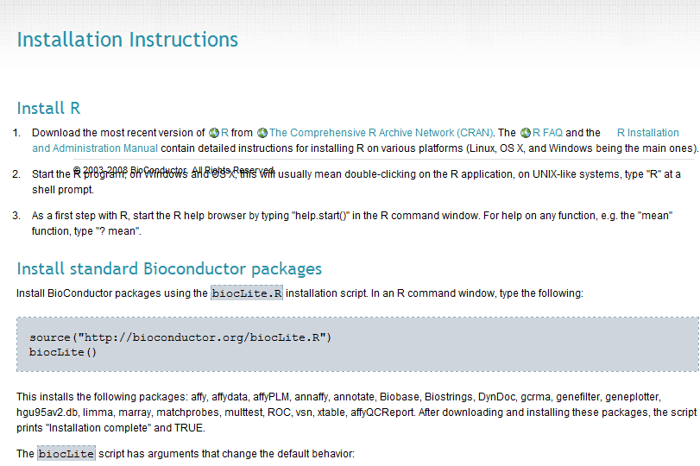
Introduction
Data analysis
Example
Microarray analysis:
B. Microarray data analysis with R (version R 2.7.2)/Bioconductor software:
Free download: http://www.bioconductor.org/docs/install/
Notes:
46

Slide 47
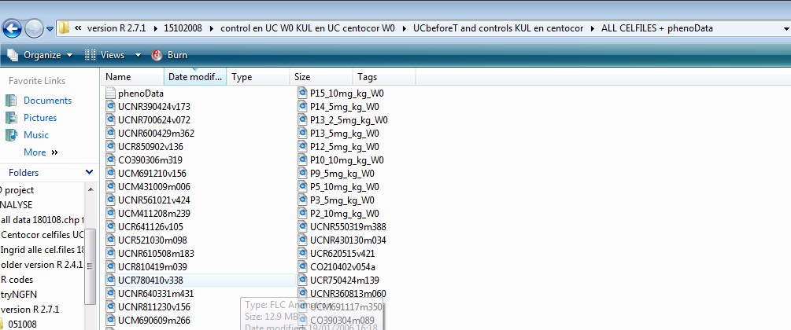
Introduction
Data analysis
Example
Microarray analysis:
B. Microarray data analysis with R (version R 2.7.2)/Bioconductor software:
Make a file with all the CEL files and phenoData.txt
Notes:
47

Slide 48
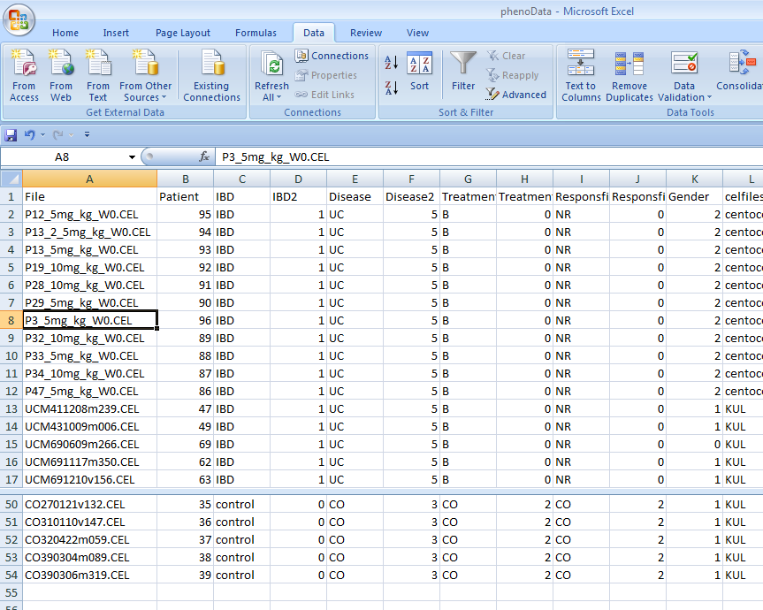
Introduction
Data analysis
Example
Microarray analysis:
B. Microarray data analysis with R (version R 2.7.2)/Bioconductor software:
Make a file with all the CEL files and phenoData.txt
Notes:
48

Slide 49
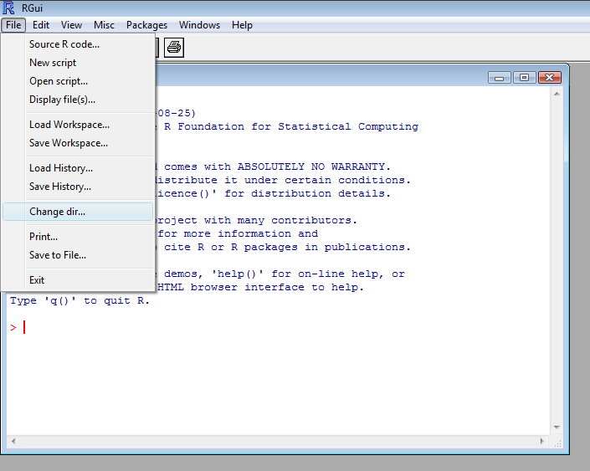
Introduction
Data analysis
Example
Microarray analysis:
B. Microarray data analysis with R (version R 2.7.2)/Bioconductor software:
Load the data in R: Go to file in R → Change dir → menu item (the file with the cel.files and phenoData.txt)
Notes:
49

Slide 50
Introduction
Data analysis
Example
Normalisation: Going from probe level data (.cel files) to expression measures for each probe set with the RMA method in package Affy. The expression measure is the data available for data analysis
R commands:
library(affy) # Loads affy package
library(hgu133plus2.db) # Loads hgu133plus2.db package
pd<-read.AnnotatedDataFrame("phenoData.txt",header=TRUE,row.names=1)
datarma<-justRMA(filenames=rownames(pData(pd)),phenoData=pd) # Creates
normalized log2 expression values using RMA method
write.exprs(datarma, file="datarma.txt") # Writes expression values to text file in working directory
Notes:
50

Slide 51
Introduction
Data analysis
Example
Non-specific filtering: To eliminate non-relevant probe sets.
  The probe sets with low overall intensity and variability that are unlikely to carry information about the phenotypes under investigation were removed. A non-specific filtering was applied on the log2 RMA normalized data (54675 probe sets) from the pre-treatment UC samples from both cohorts.
    Only probe sets with an intensity > log2(100) in at least 10% of the samples and an interquartile range (IQR) of log2 intensities across the samples > 0.5 were included, leaving 9183 probe sets for further data analysis.
R commands:
eset<-datarma[,pData(datarma)[,"Disease"]%in%c("UC")&pData(datarma)[,"Treatment"]%in%c("B")&pData(datarma)[,"Responsfinal"]%in%c("R","NR")&pData(datarma)[,"celfileszonderP13"]%in%c("centocor","KUL")] # select the pre-treatment expression profiles of both cohorts
eset # provides summary information of exprSet object 'eset’
pData(eset)
library(genefilter)
f1<-pOverA(0.10,log2(100))
f2<-function(x)(IQR(x)>0.5) # non-specific filtering leaving 9183 probe sets for further analysis
ff<-filterfun(f1,f2) -intensity of a gene should be above 100 in at least 25% of the samples
selected<-genefilter(eset,ff) -interquartile range of log2-intensities should be at least 0.5
sum(selected)
esetSub<-eset[selected,]
table(selected)
esetSub
Notes:
51

Slide 52
Introduction
Data analysis
Example
Class discovery:
For comparative analysis, package LIMMA (based on moderated t-test) was used to identify probe sets that are differentially expressed between responders (R) and non-responders (NR) at baseline (before IFX treatment) in cohort A, cohort B and both cohorts combined.
To correct for multiple testing, the false discovery rate (FDR) was estimated from p-values derived from the moderated t-statistics using the method of Benjamini and Hochberg (BH).
  Fold change (average responders/average non-responders) >2 and FDR<5% were considered statistical significant.
Notes:
52

Slide 53
Introduction
Data analysis
Example
R commands for comparative analysis between R and NR for example in cohort A:
> esetsel<-esetSub[,pData(esetSub)[,"Disease"]%in%c("UC")&pData(esetSub)[,"Treatment"]%in%c("B")&pData(esetSub)[,"Responsfinal"]%in%c("R","NR")&pData(esetSub)[,"celfileszonderP13"]%in%c("KUL")] # selects all pre-treatment UC samples of cohort A
> f<-factor(as.character(esetsel$Responsfinal)) # variable that says which sample is R or NR
> design<-model.matrix(~f) # Creates design matrix
> library(limma) # loads limma package
> fit<-lmFit(exprs(esetsel),design) # Fits a linear model for each gene based on the given series of arrays.
> fit2<-eBayes(fit) # Computes moderated t-statistics and log-odds of differential expression by empirical Bayes shrinkage of the standard errors towards a common value.
> options(digits=2)
> topTable(fit2,coef=2,adjust="BH",number=100) # Generates list of top 100 DE probe sets adjusted by BH as FDR
topTableall<-topTable(fit2,coef=2,adjust="BH",number=9183) # Generates list of all probe sets
write.table(topTableall,file="topTableall.xls",sep="\t",quote=F) # Export limma statistics table to text file
> topTablesig<-topTableall[topTableall$adj.P.Val<0.05&(topTableall$logFC>1|topTableall$logFC<(-1)),]
> dim(topTablesig) # number of significant probe sets wit >2-fold change and FDR<5%
Notes:
53

Slide 54
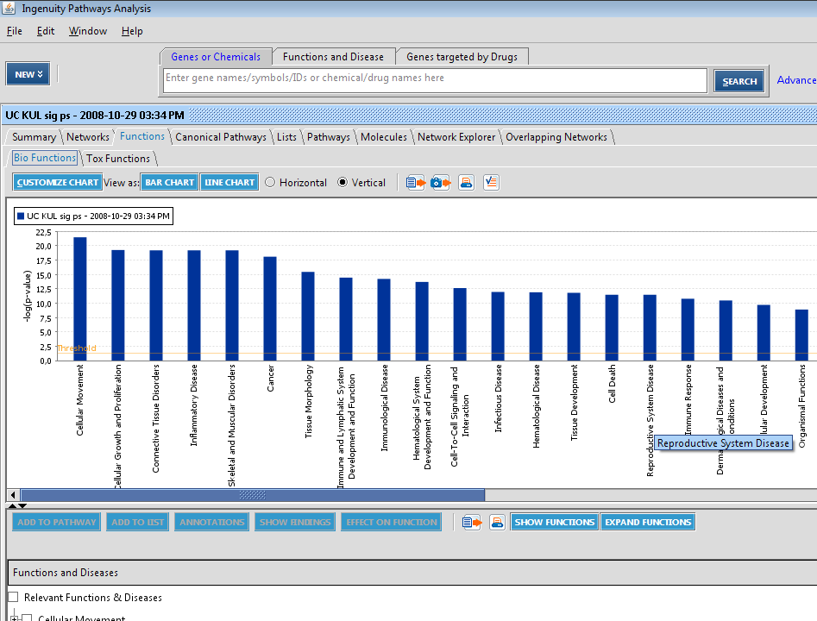
Introduction
Data analysis
Example
The Bio Functional Analysis tool in the Ingenuity Pathway Analysis (IPA) program (Ingenuity Systems®, www.ingenuity.com) was used to identify biological functions and/or diseases among sets of significant probe sets.
  Load the list of significant probe sets in IPA program and run a new core analysis
Notes:
54

Slide 55
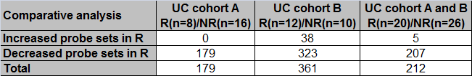
Introduction
Data analysis
Example
Results:
Comparative analysis between R and NR in cohort A, cohort B and both cohorts combined:
The significant probe sets of each pairwise comparison showed a predominance of the biological functions: immune response, cellular movement, cellular growth and proliferation, hematological system development and function, cell-to-cell signalling and interaction, cell death and tissue morphology/development.
Notes:
55

Slide 56
Introduction
Data analysis
Example
Results for comparative and IPA analyses:
Comparative analysis between R and NR in cohort A, cohort B and both cohorts combined:
The significant probe sets of each pairwise comparison showed a predominance of the biological functions: immune response, cellular movement, cellular growth and proliferation, hematological system development and function, cell-to-cell signalling and interaction, cell death and tissue morphology/development.
Notes:
56

Slide 57
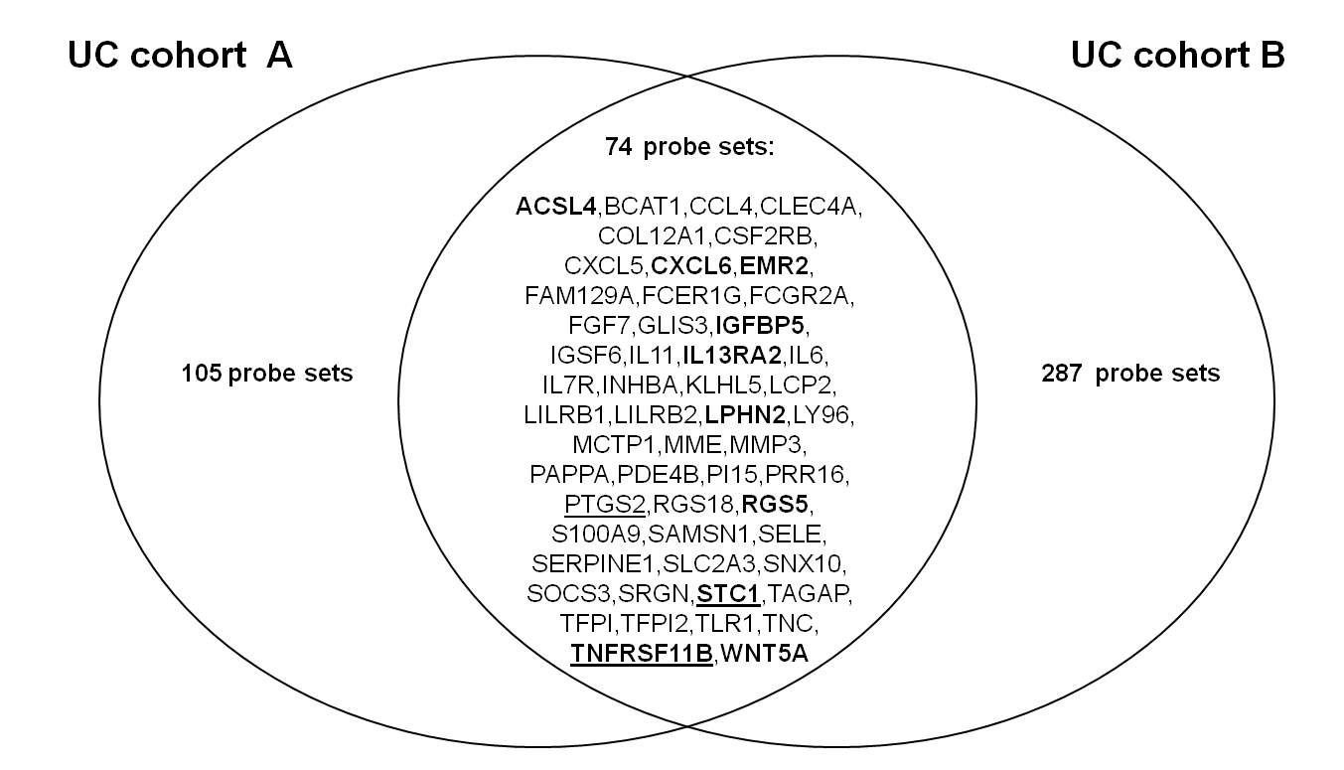
Introduction
Data analysis
Example
There was an overlap of 74 significant probe sets, representing 53 different known genes, between the LIMMA analyses in cohort A and in cohort B, and these common probe sets were all downregulated in responders as compared to non-responders
Notes:
57

Slide 58
Introduction
Data analysis
Example
Class prediction: PAM with leave-one-out cross validation was carried out on the top 5 most significantly different known genes, identified by LIMMA analysis between responders and non-responders in each cohort and both cohorts combined
  to see if these subsets accurately predict response or non-response to infliximab
  to identify the lowest misclassification error rate based on these subsets.
Unsupervised average-linkage hierarchical clustering, using Euclidian distance as metric, was applied to the log2 expression values of the top 5 significant genes from the LIMMA analysis in each cohort and both cohorts combined to visualize gene/sample relationship.
The results of the clustering were visualized as a 2-dimensional heatmap with 2 dendograms, one indicating the similarity between patients and the other indicating the similarity between genes.
Notes:
58

Slide 59
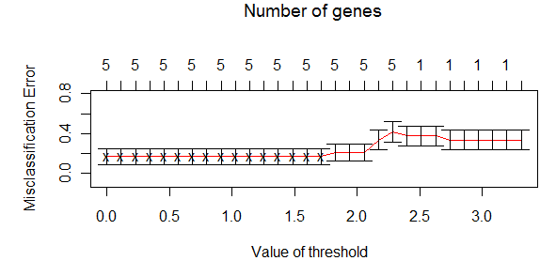
Introduction
Data analysis
Example
R commands for PAM with top 5 genes:
library (pamr) # loads pamr package
seltop5<-exprs(esetsel)[c("206172_at","210895_s_at","206953_s_at","211671_s_at","213338_at"),] # selects top 5 genes
pData(esetsel)[,"Responsfinal"]<-factor(as.character(esetsel$Responsfinal))
labels<-esetsel$Responsfinal # variable for response to IFX
set.seed(4)
dat<-seltop5
gI<-rownames(dat)
sI<-as.factor(colnames(dat))
train.dat<-list(x=dat,y=labels,geneid=gI,sampleid=sI)
model<-pamr.train(train.dat)
set.seed(4)
model.cv<-pamr.cv(model,train.dat,nfold=10)
model.cv
source("C:\\PhD and postdoc project\\course liege 20112012\\nsccv.R")
objects()
ncv <- length(train.dat$y)
ncv
set.seed(4)
model.cv<-MYpamr.cv(model, train.dat, folds=as.list(seq(ncv))) # PAM with leave-one-out cross -
pamr.plotcv(model.cv) validation and threshold 1.26
Delta=1.26
pamr.confusion(model.cv,Delta)
listtop5<-pamr.listgenes(model,train.dat,Delta)
write.table(listtop5, "pamrall_listgenestop5genes.txt", sep='\t', quote=F)
pamr.plotcen(model,train.dat,Delta)
pamr.geneplot(model,train.dat,Delta)
pamr.predict(model,seltop5,Delta,type="posterior")
Notes:
59

Slide 60
Introduction
Data analysis
Example
R commands for hierarchical cluster analysis with top 5 genes:
dat<-seltop5
d<-dist(dat)
hc<-hclust(d,method="average")
d2<-dist(t(dat))
hc2<-hclust(d2,method="average")
library(gplots) # average-linkage hierarchical clustering, using
color.map<-function(Responsfinal){if(Responsfinal=="R")"#FF0000"else"#0000FF"} Euclidian distance as metric with heatmap as
patientcolors<-unlist(lapply(esetsel$Responsfinal,color.map)) result
heatmap.2(dat,col=topo.colors(100),cexRow=0.6,cexCol=0.8,scale="none",key=TRUE,symkey=FALSE,density.info="none",trace="none",labCol=labels,margins = c(2,8),Rowv=as.dendrogram(hc),Colv=as.dendrogram(hc2),ColSideColors=patientcolors)
Notes:
60

Slide 61
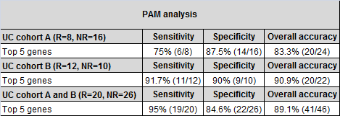
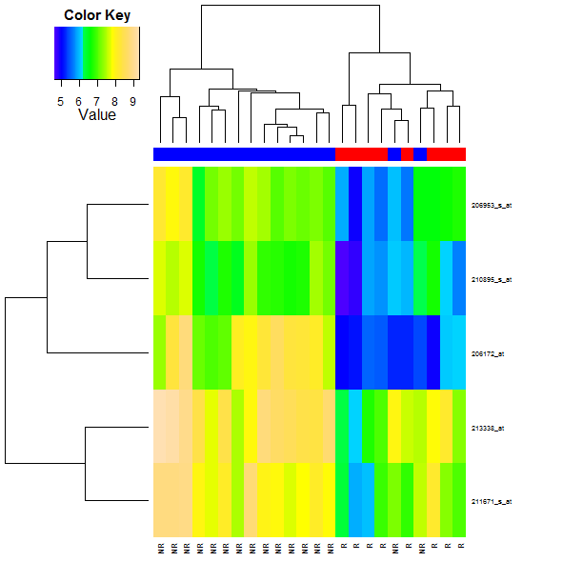
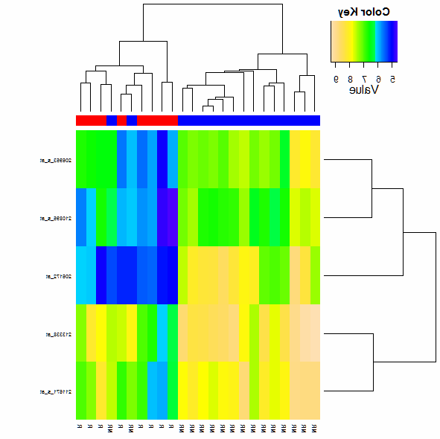
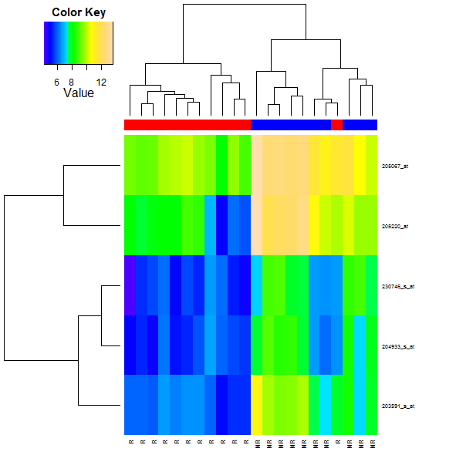
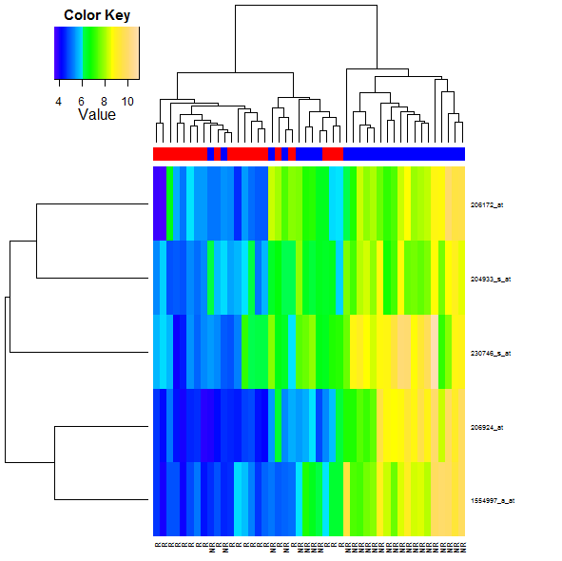
Introduction
Data analysis
Example
Results for PAM and hierarchical cluster analyses:
PAM analysis of the top 5 significantly genes:
Hierarchical cluster analysis of the top 5 significantly genes:
Cohort A:
Cohort B:
Cohort A and B:
R
R
NR
NR
Notes:
61
Hierarchical cluster analysis of responders (R) and non-responders (NR), based on the log2 expression values of the top 5 significantly differentially expressed known genes**, identified by LIMMA analysis in cohort A, cohort B, the two cohorts combined.Individual samples are shown in colums and genes in rows. The log2 expression values for individual genes are indicated by color, as shown in the scale (color key), with yellow indicating a high level of expression and blue a low level of expression. The responders (R) and non-responders (NR) are coloured red and blue, respectively. **For probe sets representing the same gene, the most significant probe set representing that gene was taken for the analysis.

Slide 62

Introduction
Data analysis
Example
Conclusion
Gene array studies of UC mucosal biopsies identified predictive panels of genes for (non-)response to infliximab in pre-treatment mucosal biopsies of patients who received for the first time infliximab therapy in two cohorts of patients.
Our studies demonstrate that differences in mucosal expression of a limited number of genes involved in the inflammatory cascade account for resistance of UC to respond to infliximab therapy.
Further study of the pathways involved should allow to better understand mechanisms of the resistance to infliximab therapy in UC.
Notes:
62

Slide 63






Introduction
Data analysis
Example
Interesting books
Notes:
63

Slide 64


Introduction
Data analysis
Example
Affymetrix file types:
DAT file
The image of a scanned probe array
Process image
(GCOS)
CEL file = processed .DAT file
It contains a single intensity value
for each probe cell delineated by the grid
MAS5
(GCOS)
CDF file (=chip description file): Provided by Affy, describes layout of chip
CHP file: Experiment results created from CEL and CDF files
RPT file: Generated by GCOS, report of quality control (Quality evaluation included Spike-In controls (BioB, BioC, BioD, and cre), a 3’-5’ ratio of GAPDH < 3.0, and average background signal < 100)
Notes:
64
64

Slide 65


Introduction
Data analysis
Example
The synthesis of these oligonucleotides on GeneChip microarrays are based on the concept of photolithography
Light is shined through a mask onto a chip that has initial starting strands where the DNA will be built from
The mask has specific tiny openings that allow the light to come in contact with the wafer at specific sections (in this diagram there are 5 probes only and each could represent a different feature)
Any place where light hits, removes a “protective” group from the strands
Free nucleotides (the red T) are washed over the chip and the nucleotides will combine with any strand that had lost its’ protective group in the previous step
This is then repeated (shine light through a mask, deprotect the strands, add free nucleotides) numerous times until a each strand built is 25 base pairs long
Notes:
65
65

Slide 66

Introduction
Data analysis
Example
Probe set design:
  A group of oligonucleotide-probe pairs designed to detect the expression level of one gene transcript. Two oligonucleotides (25 bases) designed to be complementary to a reference sequence, of which one has a mismatch at the 13th position, define a probe pair. Mismatch probes serve as control for non-specific cross-hybridization. A probe set on the Affymetrix Human Genome U133 Plus 2.0 Array contains 11 probe pairs.
Notes:
66
66

Slide 67

Introduction
Data analysis
Example
Class prediction experiment:
  PAM method
    Nearest shrunken centroid method:
      Modification of nearest centroid method, which computes a standardized centroid for each class in the training set. This is the average gene expression for each gene in each class divided by the within-class standard deviation for that gene.
        Nearest centroid classification takes the gene expression profile of a new sample, and compares it to each of these class centroids. The class, whose centroid it is closest to, in squared distance, is the predicted class for that new sample.
      Nearest shrunken centroid classification makes one important modification to the standard method. It "shrinks" each of the class centroids toward the overall centroid for all classes by an amount we call the threshold. This shrinkage consists of moving the centroid towards zero by subtracting the threshold, setting it equal to zero if it hits zero. For example if threshold was 2.0, a centroid of 3.2 would be shrunk to 1.2, a centroid of –3.4 would be shrunk to –1.4, and a centroid of 1.2 would be shrunk to zero.
        After shrinking the centroids, the
        new sample is classified by the usual
        nearest centroid rule, but using the
        shrunken class centroids.
Biological question
Experimental design
Microarray experiment
Image analysis
Normalization
Data analysis
Biological verification
and interpretation
Making data public
Notes:
67
67

Slide 68

Introduction
Data analysis
Example
Class prediction experiment:
  PAM method
    Nearest shrunken centroid method:
      The shrinkage has two advantages:
        (1) it can make the classifier more accurate by reducing the effect of noisy genes
        (2) it does automatic gene selection for genes that characterize the classes.
          In particular, if a gene is shrunk to zero for all classes, then it is eliminated from the prediction rule. Alternatively, it may be set to zero for all classes except one, and we learn that high or low expression for that gene characterizes that class.
Biological question
Experimental design
Microarray experiment
Image analysis
Normalization
Figure: Identification of diagnostic markers by PAM. The shrunken class centroids for genes which have at least one nonzero difference are shown. The genes with nonzero components in each class were almost mutually exclusive and were the candidate molecular markers for the diagnosis of the four groups of cell populations
Data analysis
Biological verification
and interpretation
Making data public
Notes:
68
68

Slide 69

Introduction
Data analysis
Example
Class prediction experiment:
  PAM method
    Nearest shrunken centroid method:
      The user decides on the value to use for threshold Δ.
      Choosing Δ with cross-validation
        PAM does K-fold cross-validation for a range of threshold values.
          The samples are divided up at random into K roughly equally sized parts. For each part in turn, the classifier is built on the other K-1 parts then tested on the remaining part. This is done for a range of threshold values, and the cross-validated misclassification error rate is reported for each threshold value.
Biological question
Experimental design
Microarray experiment
Image analysis
Normalization
Data analysis
Biological verification
and interpretation
Making data public
Notes:
69
69

Slide 70

Introduction
Data analysis
Example
Class prediction experiment:
  PAM method
    Nearest shrunken centroid method:
      Choosing Δ with cross-validation
        Typically, the user would choose the threshold value giving the minimum cross-validated misclassification error rate.
Biological question
Experimental design
Microarray experiment
Image analysis
Normalization
Data analysis
Biological verification
and interpretation
Making data public
Notes:
70
70

